Slide 1

PlaatEnergy (Energy Data Logger) Private Open Source Project
W.B.J. van der Plaat
(Software Architect)

Slide 2

Question
How many energy is my house using daily?
How many gas is my heater using daily?
How many energy is my solar system deliver daily?
How many solar power is directly consume by my house?

Slide 3

Idea
Lets create an application which measures everything
Records every minute energy and gas usage
Records every minute solar energy delivered
Records every minute environment temperature, humidity and pressure
Create User friendly Web GUI
Use low cost, low energy hardware

Slide 4
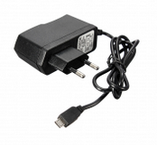
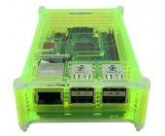

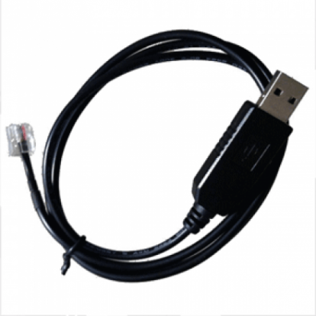
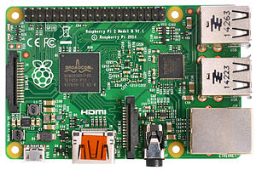
Used hardware
Raspberry Pi 3B
USB to P1 Cable
Micro SD card (16GB)
USB power supply
Raspberry Pi Case

Slide 5
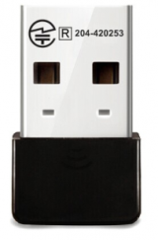
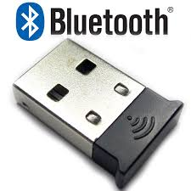
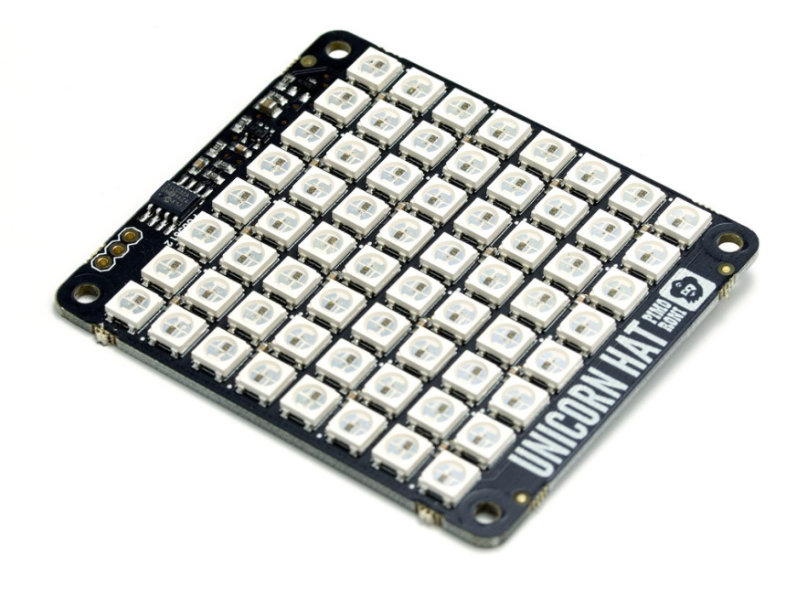
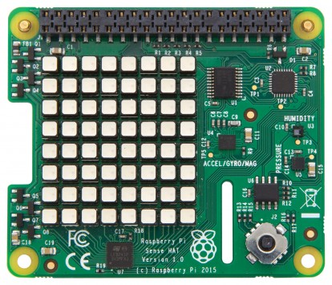
Optional hardware
Wifi USB Dongle
Bluetooth USB Dongle
Pi Sense Hat
Unicorn Hat

Slide 6
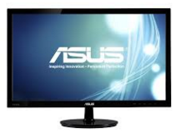
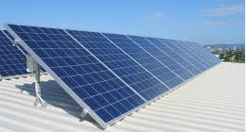
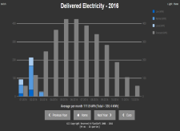
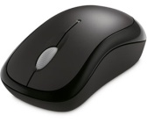

Hardware view – Configuration 1
HDMI
Omnik Solar
Converter
Raspberry Pi
PlaatEnergy
Pi Sense Hat
Wifi
Wifi Router
Ethernet
USB
USB

Slide 7
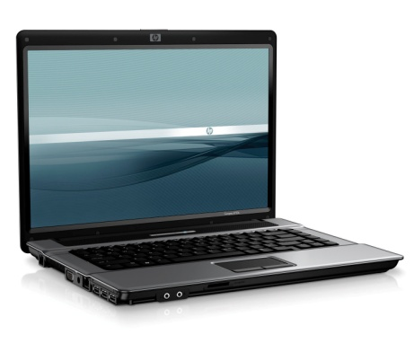
Hardware view – Configuration 2
P1 cable
Digital Energy
Meter
Bluetooth
Digital Gas
Meter
Omnik Solar
Converter
USB
Raspberry Pi
PlaatEnergy
Sense Hat
Wifi
Wifi Router
Ethernet
Ethernet
ADSL Router
PlaatEnergy
Reachable on
internet
UTP
Internet

Slide 8
Hardware view – Configuration 3
P1 cable
Digital Energy
Meter
Bluetooth
Digital Gas
Meter
Hosola Solar
Converter
Hosola Solar
Converter
Hosola Solar
Converter
USB
Wifi
Raspberry Pi
PlaatEnergy
Unicorn hat
Wifi
Wifi
Wifi Router
ethernet
Ethernet
PlaatEnergy
Reachable on
internet
ADSL Router
HDMI
UTP
PlaatEnergy
slide show
at
monitor
Internet

Slide 9
PlaatEnergy Software Architecture
Google Charts
Weather Service
JSON
Presentation Layer
PHP/CSS/JS
Apache
Business Logic Layer
PHP
Database Layer
MySQL
Solar Converter
Interface
Energy Meter
Interface
Environment
Interface
Display
Interface
PHP/ “Python”
Operating
System
Debian Linux
Vendor Support
Omnik
Hosola
Vendor support
Kaifa
Landis
kamstrup
Vendor support
Pi onboard
Pi Sense Hat
Vendor support
Pi Sense Hat
Unicorn Hat

Slide 10
PlaatEnergy Key features
Measure each device every minute
User friendly web interface
Show real-time, historical and forecast data
Show financial data
Support measurement corrections
Export measure data to CSV and SQL
Custom Data Report
Open Source and free to use!
Automatic data model patching when upgrading
Secure access to Web GUI and settings

Slide 11
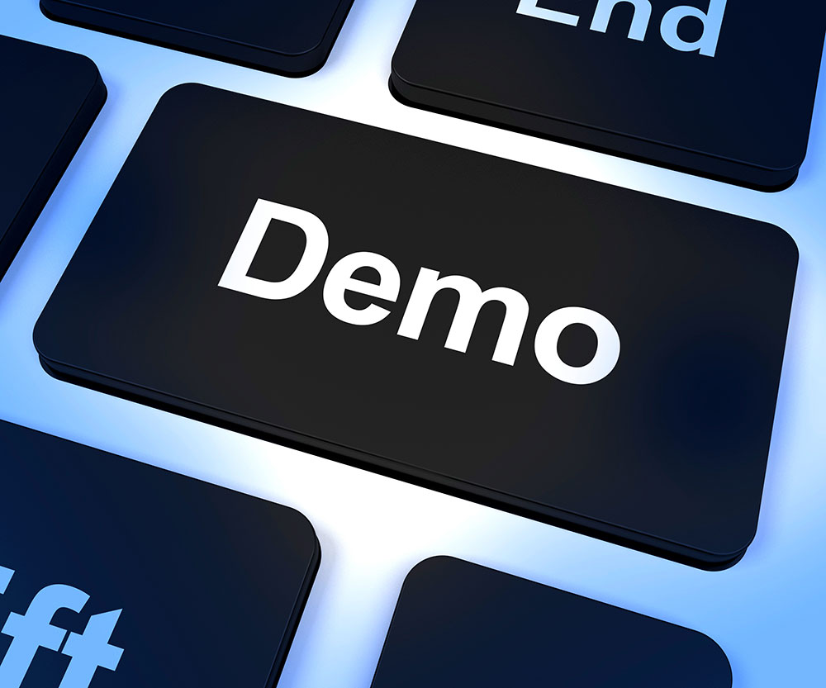

Slide 12
Conclusion
My energy use is dropped with 25%
My gas use is dropped with 50%
because I am more aware now.
PlaatEnergy is downloaded ca. 120 times “Customers” sending great feedback back ☺
SOS Solutions. One of the biggest Raspberry Pi resellers in the Netherlands will sell soon a Pi Smart Energy Kit with includes PlaatEnergy ☺

Slide 13
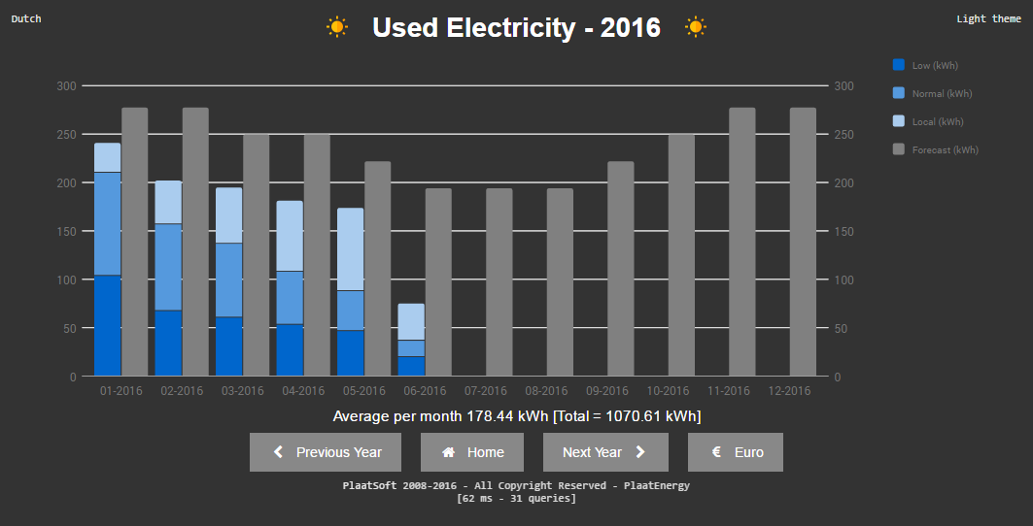

Slide 14
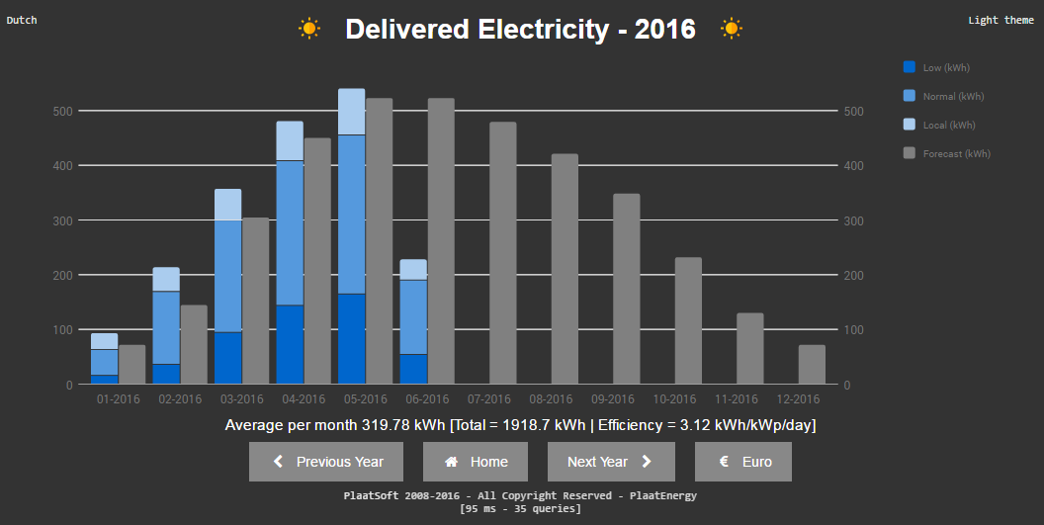

Slide 15
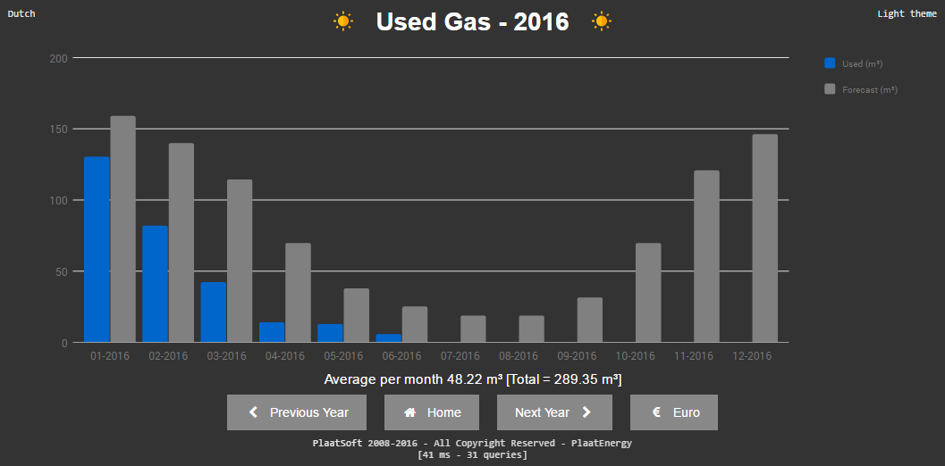

Slide 16
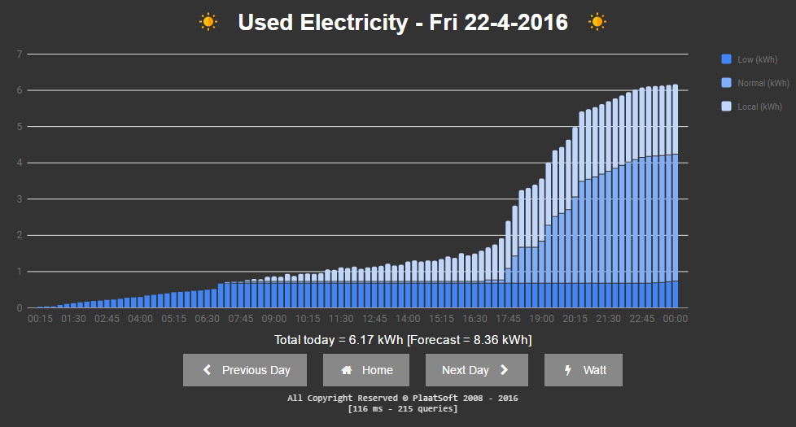

Slide 17
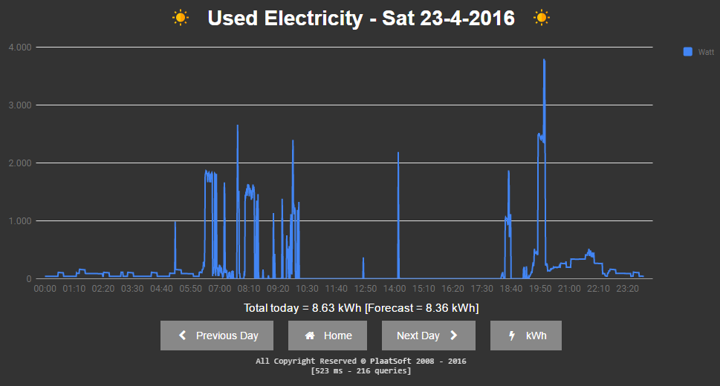

Slide 18
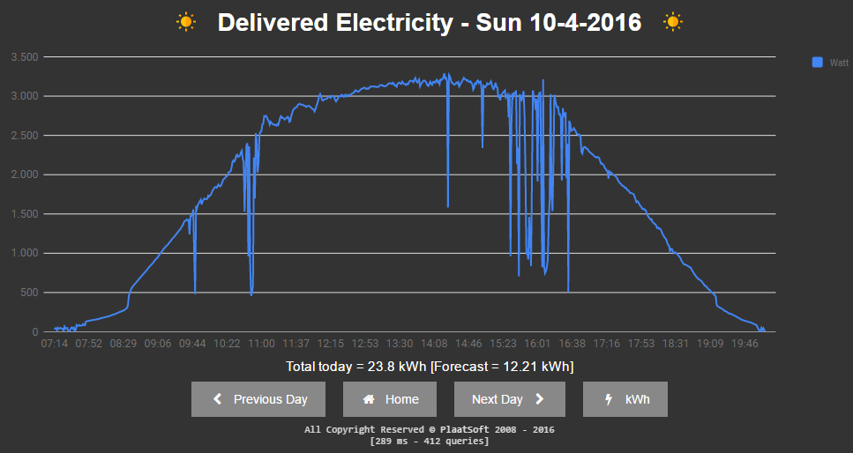

Slide 19
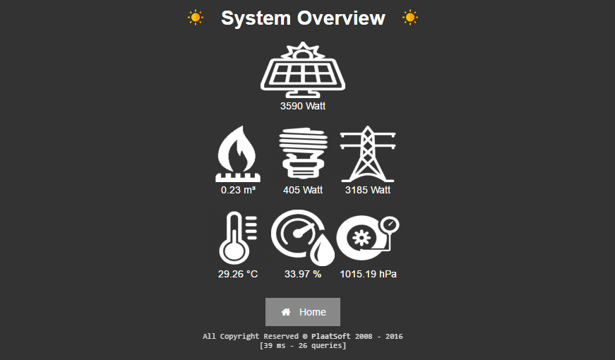

Slide 20


Slide 21

PlaatProtect (Burglar / Fire Alarm Centre) Private Open Source Project
W.B.J. van der Plaat
(Software Architect)

Slide 22


Next project - PlaatProtect
Burglar / Fire Alarm Centre running on Raspberry Pi
Integrate Webcams
Motion detection with auto recording
Integrate Zigbee meshwork
Control lights in my house (Philips Hue)
Fire detector (Google Nest Protect)
Push alarm notifications to Mobile
Integrate Z-Wave meshwork
IR detector(s)
Alarm Horn
Keypad

Slide 23
PlaatProtect Software Architecture
Google Charts
Notification Service
JSON
Presentation Layer
PHP/CSS/JS
Apache
Business Logic Layer
PHP
Database Layer
MySQL
Light
Interface
Zigbee
Interface
Z Wave
Interface
Webcam
Interface
PHP/ “Python”
Operating
System
Debian Linux
Vendor Support
HUE Philips
Vendor support
Google Protect
Vendor support
- Aeotec
- Aeon
Vendor support
Sony PS2 webcam

Slide 24
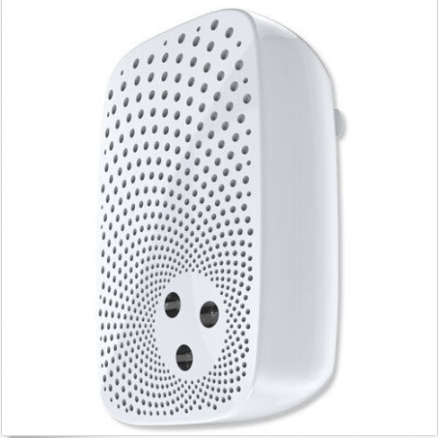
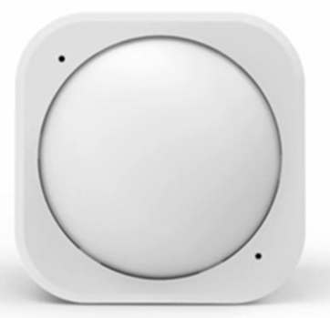
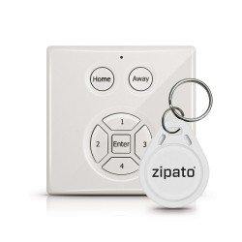
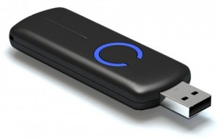
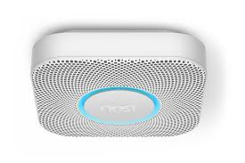
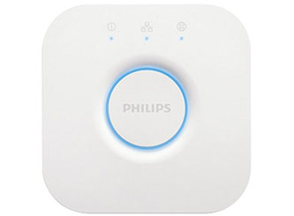
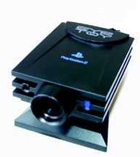
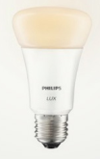
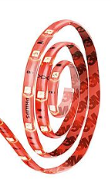
Used hardware
Philips Hue Bridge
Philips Hue Lamps / Strips
Z-Wave USB Dongle
Z-Wave Horn
Z-Wave IR detector
Z- Wave Keypad
Google Nest Protect
USB Webcam

Slide 25
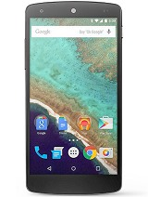
Hardware view – Configuration 4
P1 cable
Digital Energy
Meter
Light
Strip
Bluetooth
Bulb
Digital Gas
Meter
Solar
Converter
USB
Zigbee
(mesh network)
Raspberry Pi
PlaatEnergy
PlaatProtect
Sense Hat (Pi)
Wifi
Wifi
Wifi Router
Ethernet
USB
Z Wave
(mesh network)
Ethernet
ADSL Router
USB
USB
UTP
IR Detector(s)
Alarm
Horn
Alarm
Push
Message
Internet
Webcam
1
Webcam
2
Keypad
with ID tags

